Slide 1
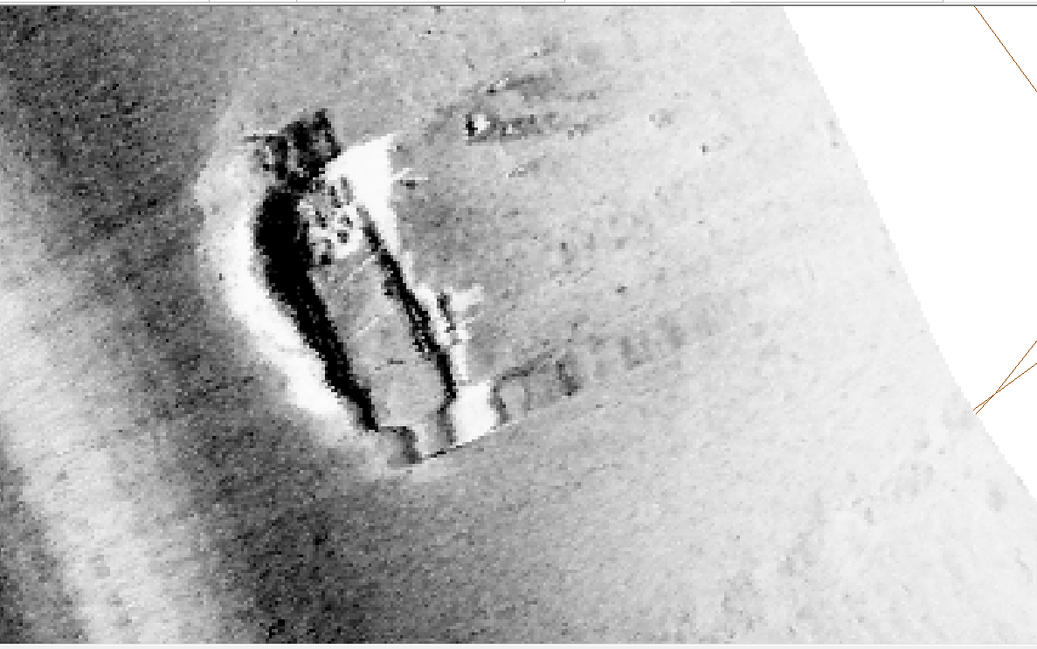
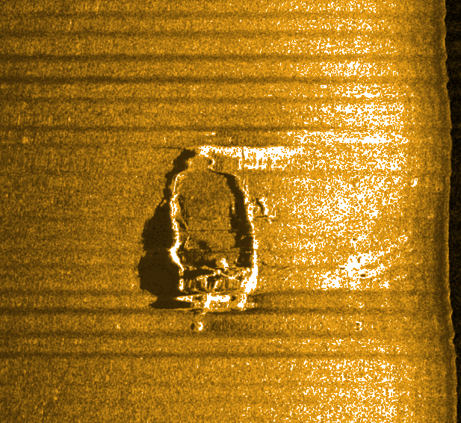
Y
W
Z
V
x
x
V
Z
Y
W
OpenSidescan
V | 68.828257 | 48.445629
W | 68.828268 | 48.445548
X | 68.828327 | 48.445632
Y | 68.828370 | 48.445703
Z | 68.828345 | 48.445666
Caris
Sidescan file: scotsman5.xtf

